Slide 1
Review-3 Hand Gesture Recognition
Eppali Pravallika - 2010030046
Tahseen Begum - 2010030168
M.Rushitha Sri - 2010030362
K.Kavya - 2010030550
Under the Guidance of
Dr. N. Chiranjeevi
Professor
Computer Science and Engineering Department
KL Hyderabad Off Campus, Aziz Nagar, Hyderabad

Slide 2
Overview
Introduction
Objectives of the Project
Algorithm
Implementation Details
Results
Final Outputs
References

Slide 3
Introduction
Hand gesture recognition is a field of computer vision focused on interpreting gestures made by human hands. It involves capturing and analyzing hand movements using cameras or sensors.
These gestures can convey commands, interactions, or expressions in various applications such as sign language translation, human-computer interaction, and virtual reality.
It involves detecting and recognizing gestures made by the hand, which can convey various commands or messages.
This technology finds applications in sign language translation, human-computer interaction, and virtual reality, among others.
Hand gesture recognition holds promise for intuitive and natural interaction with devices and systems.

Slide 4
Objectives of the Project
Objective 1: Alphabet's to Sign Language Converter
Alphabet's text to Sign Language Converter utilizes translated written text into Sign Language gestures, enhancing accessibility for the deaf and hard-of-hearing community.
Objective 2: Words to Sign Language Converter
Words to Sign Language Converter translates spoken or written words into sign language gestures, aiding communication for the deaf or hard of hearing. It typically recognizes words and generates corresponding sign language representations.
Objective 3: Speech to Sign Language Converter
Speech to Sign Language Converter translates spoken language into sign language gestures, facilitating communication between deaf individuals and those who are not fluent in sign language. It recognizes speech patterns and generates corresponding sign language gestures in real time.

Slide 5
Techniques
Hand gesture recognition involves using computer vision and machine learning techniques to interpret hand movements and gestures captured through cameras.
Hand gesture recognition combines computer vision with machine learning. Libraries like Mediapipe and OpenCV handle hand detection, tracking, and landmark estimation. Sci-kit is used for training classification models, TensorFlow for deep learning, Matplotlib for visualization, and Pandas for data manipulation. This toolkit enables capturing, processing, training, and deploying models for real-time recognition applications.
Together, these tools form a comprehensive toolkit for developing hand gesture recognition systems, encompassing data acquisition, preprocessing, model training, and evaluation. The process involves capturing hand gestures using a camera, processing the images with computer vision techniques to extract relevant features, training machine learning models to classify these gestures, and finally deploying the trained model for real-time recognition applications.

Slide 6
Implementation Details
2010030168_Tahseen Begum - working on coding.
2010030046_Eppali Pravallika - working on sign language converter and website
2010030362_Rushitha Sri - working coding
2010030550_K.Kavya - working on documentation.

Slide 7
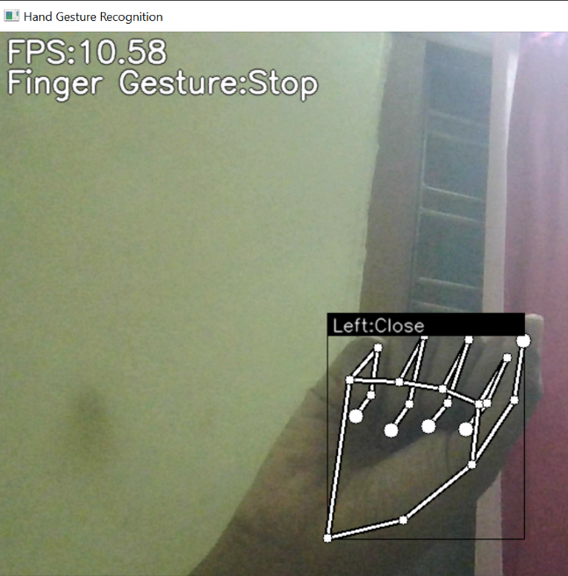
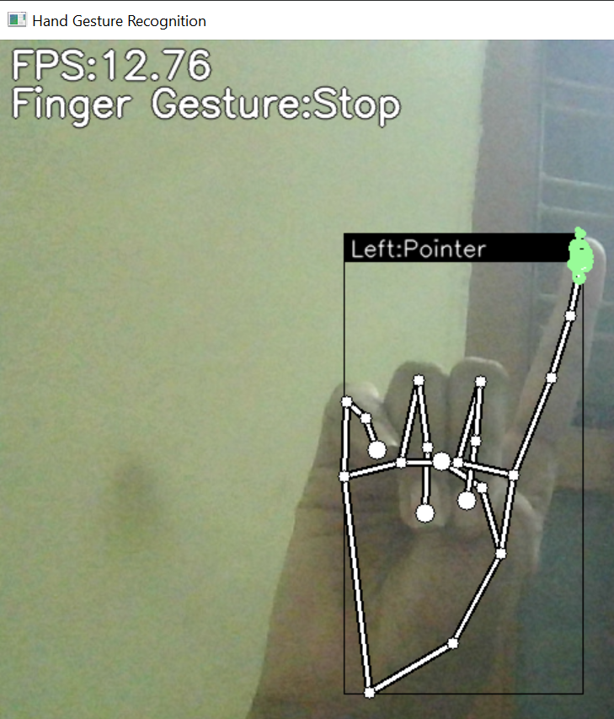
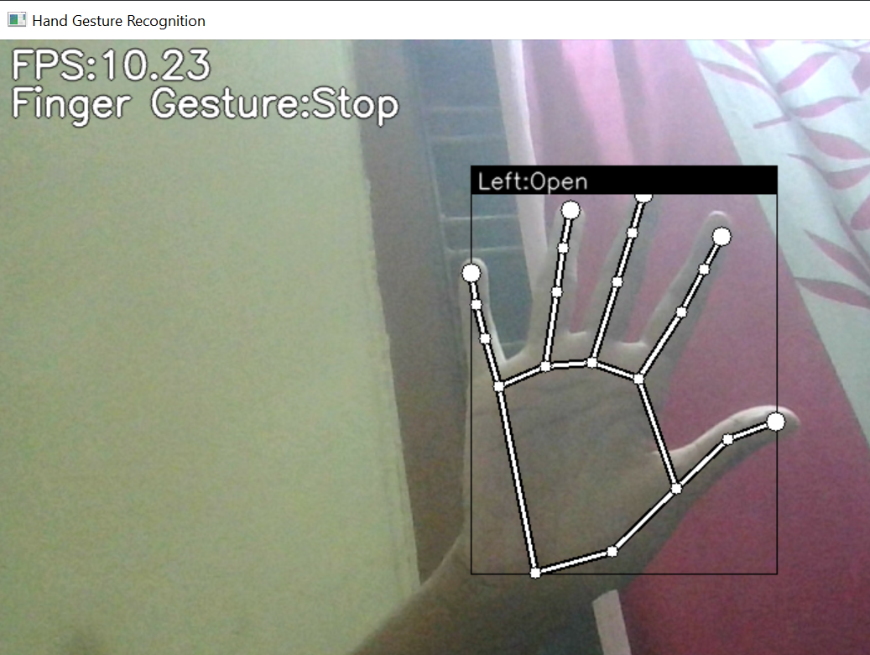
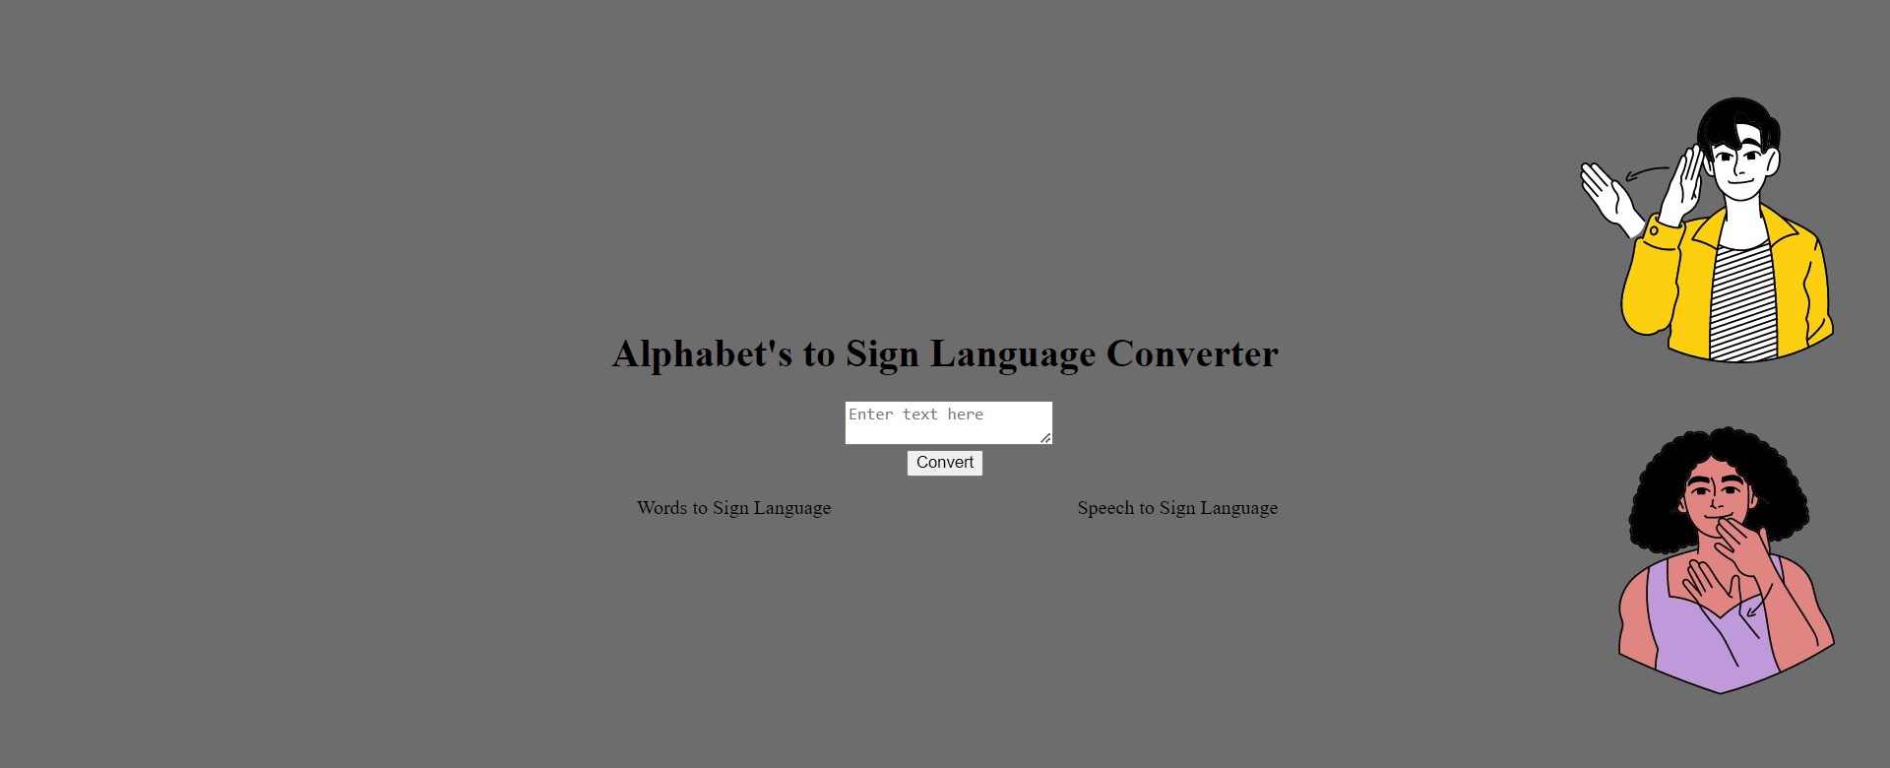
Results
Hand Recognition
Sign Language converter

Slide 8
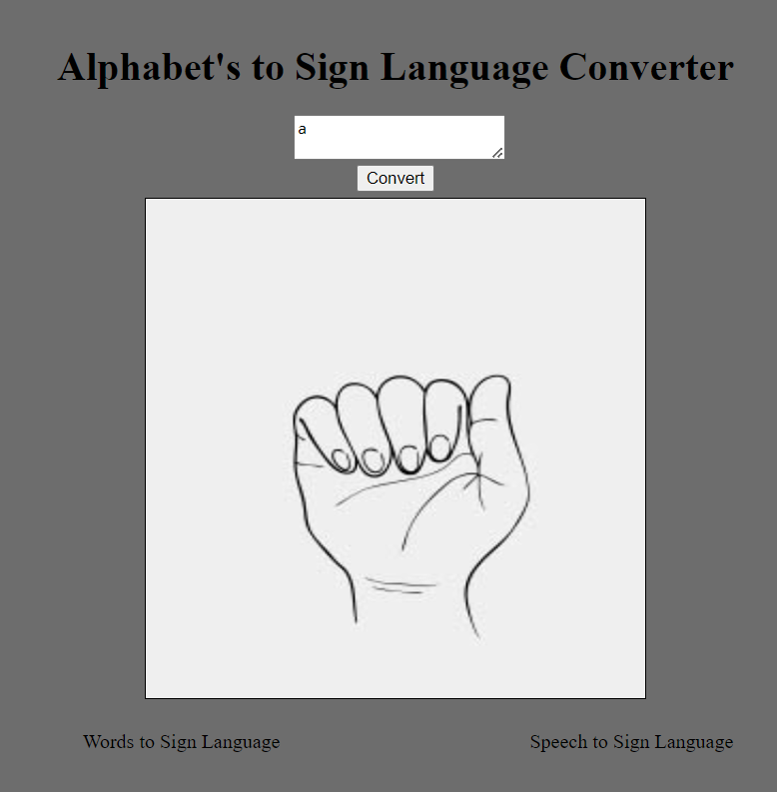
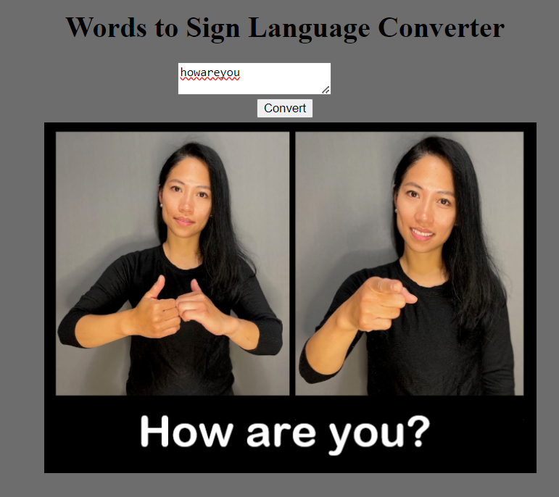
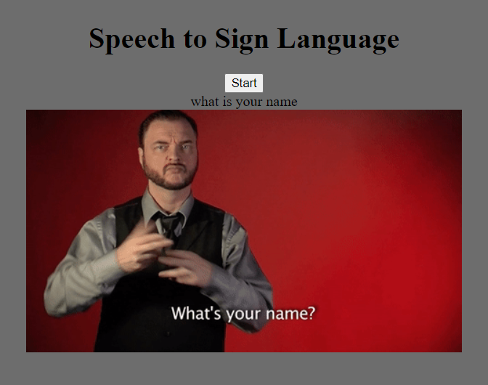

Slide 9
References
https://www.researchgate.net/publication/320437730_Hand_Gesture_Recognition_for_Human_Computer_Interaction
https://www.ncbi.nlm.nih.gov/pmc/articles/PMC8976610/
https://www.warse.org/IJATCSE/static/pdf/file/ijatcse118922020.pdf
https://www.hindawi.com/journals/jece/2019/4167890/
https://www.mdpi.com/2076-3417/11/9/4164

Slide 10
Thank you

